Slide 1
The Release Pipeline in Practice
Graduating from the School of Michael Greene
ANY SUPPORTING CODE AND DOCUMENTATION AT https://github.com/matthitchcock/PSConfEU17-ReleasePipelineinPractice
Matt Hitchcock, Senior Consultant @ Microsoft Singapore

Slide 2
Agenda
Introduction
Background on the Release Pipeline
How a Release Pipeline works and example architecture
My experiences implementing with a Customer
Summary

Slide 3
TL;DR
The Release Pipeline Whitepaper and Demo CI repo give you a good start for starting an Infra-as-Code initiative, but when you move to a Production scenario, you run into some challenges that will hold you up. These take time to get through, so progress on your first project can be slow. Also, the more people you're changing, the more you're time this will take, not everyone will be as thrilled as you but if you keep at it, good things will come.
Automation is magical :D

Slide 4
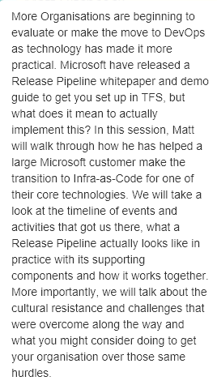
The best laid plans of mice and men …
In this session, Matt will:
Walk through how he has helped is helping a large Microsoft customer make the transition to Infra-as-Code
We will take a look at the timeline of events and activities that got us there to where we currently are
We will talk about cultural resistance and challenges that were overcome that we are working through

Slide 5
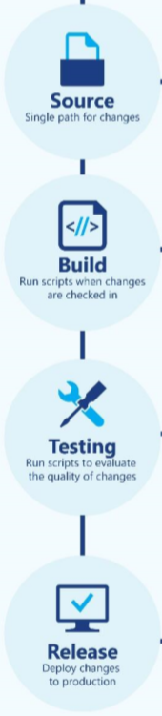
What the Release Pipeline (and Demo_CI) is
A Process, a Workflow that will take your Code Changes from a Repository to Production
It automates your Testing to provide Fast Feedback of issues
It’s a developer system of work that as we do Infra-as-Code or Configuration Management, is relevant to Operations too
Demo_CI enables you to build a starting Demo for Infra-as-Code using Microsoft tools
Notes:
I am a Consultant at Microsoft. Right now, I am working with a customer, a bank, to start getting their Windows platform onto an infra-as-code approach.
The driver for this is based on some stability issues with Hyper-V which underpins their Private Cloud. There have been incidents in the past that have caused disruption and have been the result of incorrectly implemented changes that perhaps were not sufficiently tested.
This happened last July. Following the incident, I presented an approach for managing the platform as code. This included DSC & Pester but was really immature and certainly was not a full Release Pipeline. There was a lot I didn’t know at the time.
Then, I went to Don Jones DSC Bootcamp, Michael and Mark were there presenting their Demo CI which basically was a big ah-ha and lightbulb moment and allowed me to plug a lot of things together.
This allowed me to basically create a visualisation of all the parts working together and I came up with something like this … [NEXT SLIDE]

Slide 6
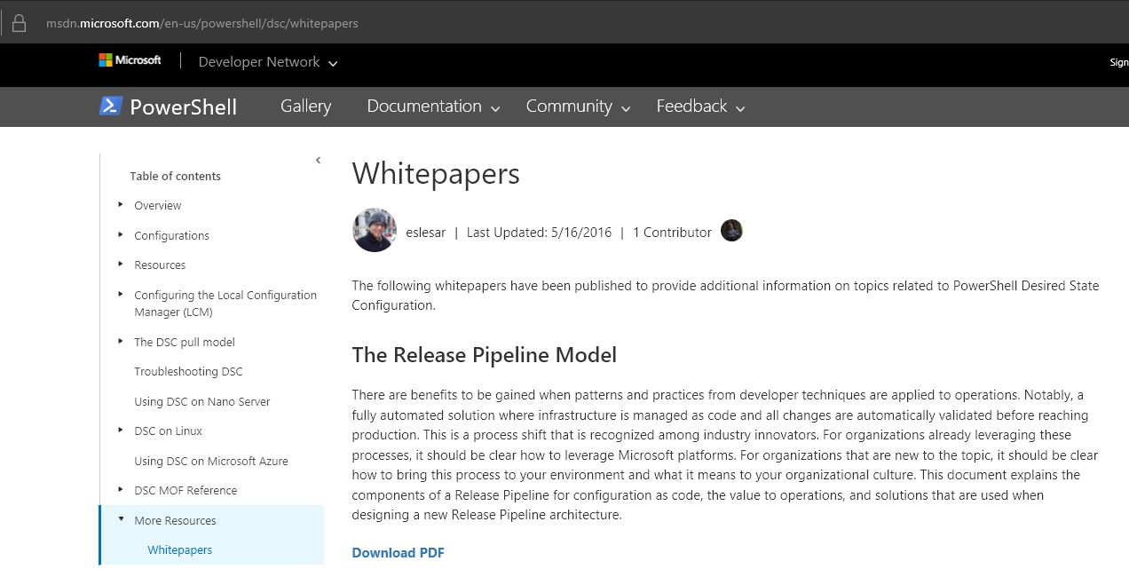
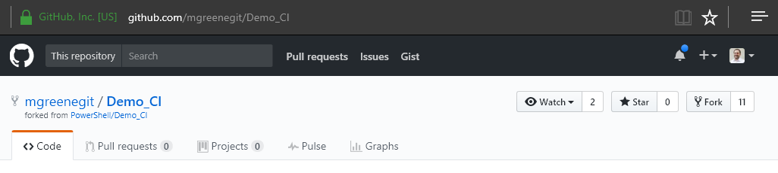
Introducing the Release Pipeline
https://aka.ms/trpm
https://github.com/mgreenegit/Demo_CI
Notes:
The organization wanted to start adopting Infra-as-Code/Configuration Management but didn’t know where to start
These resources made a great demo and starting point which I delivered and from there, the customer said “conceptually this looks great, but we don’t quite understand the big picture”
How will this change us, what is the skill involved? What do we need to know, what processes do we need to change? Etc. – we don’t really know how to answer this until we know in more detail how it works, so I had to put time into that
What does an enterprise architecture for this thing look like on a Microsoft stack? The demo and white paper are cool but they only delivered the higher level thinking and the Lower level detail but not the middle level view.

Slide 7

Still unanswered questions, feels a bit …
https://img.youtube.com/vi/J1gAHil89Z4/0.jpg
Notes:
Still feels like something only the chosen few could do
So first, I began to tackle the architecture question – what would that look like? How do we manage artifacts? How do we write our Tests. How do we use our tests? What’s the workflow involved? How do we separate Environments and Data from Code? How do we identify what the team needs to learn?
How do we actually do this? And I realized a lot of it was staring me in the face all along …

Slide 8



The “Miyagi” moment …

Slide 9
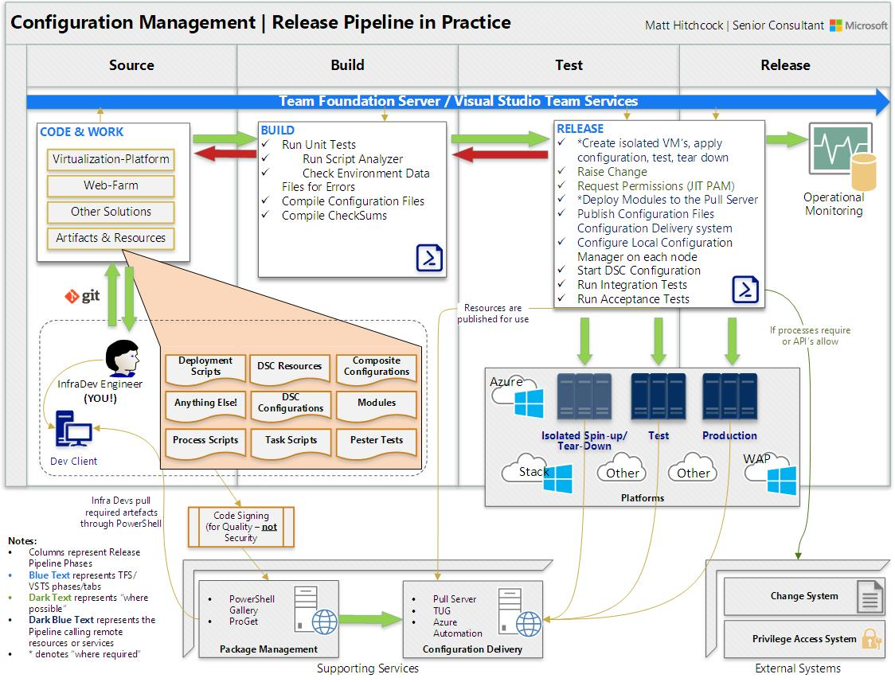
Notes:
This diagram basically produced the ah-ha moment for my customer too. I had sold them on the approach with a lot of open questions about how it would be managed and how it would operate. Fortunately they trusted me and we were trying to find our way forward but piecing together the Demo CI with the different tools Microsoft have to deliver Configuration Management (on premises) allowed me to come up with this.
Diagram explanation. This is the missing piece for most people who are looking to do DSC Configuration Management.
Release Pipelines tend to differ based on the Solution you’re delivering but this one shows a generic solution and the idea is to show all the pieces in play.
So now we know what the Architecture looks like, how do we use it?
LEADS TO DEMO
Have Karate Kid photo’s that rotate to the Visio!

Slide 10
Demo – The Release Pipeline
Notes:
Now we are going to do some demo. What I want to do here is go through the motions of how we would manage this environment as-code, this is for the folks who are not yet doing this but who think they want to. And my intention here is to give you a feel for what the daily cycle is like and a feel for how our job changes when we actually start doing this. Don’t worry about understanding how everything works, just watch what I do.
It’s a simple demo, we are basically going to:
Make a configuration change – add a hotfix to our Web Farm
Add an additional Node
Steps
Overview of my set up
Detail notes here
Log into the Dev Workstation and open TFS Portal
Manage my Work Items – Create a Branch for my work – point out that there are many strategies for Branching and Merging, pick what works for you
Clone the repo
Add code
Ensure Hotfix is not present
Unit Test
Integration test
Acceptance Test
Commit & Push
Build
Release
Pull Request
Delete Branch
Manage my work items – pick next card to add a hotfix
Create a branch
Clone the repo
Add code
Ensure Hotfix is present
Unit Test
Integration test
Acceptance Test
Commit & Push
Build
Release
Pull Request
Delete Branch
Close the work item
Manage my work items – pick next card to add a Node
Create a branch
Clone the repo
Add code
Ensure Hotfix is present
Unit Test
Integration test
Acceptance Test
Commit & Push
Build
Release
Pull Request
Delete Branch
Close the work item
Explain that there are many ways in which to do Master merge flow, GitFlow for example, choose your own based on what’s right for you and your comfort level.

Slide 11

How has the experience been?

Slide 12
Challenges to overcome …
Technical
How to manage Credentials
How to Orchestrate a Release
Environment issues!
DSC Resource Gaps
Locked down Desktop!
Change how we think about Infra
People
Prioritization of the project
Silent Resistance
Skills Development
Comfort Zone
Change how we think
Notes:
So that is how the team I am working with are now starting to work, that’s the new Normal. This is a big change to how they have always worked and it has taken a lot of time to get to where we are. Challenges include:
Technical
Filling in the gaps
Credential Management
Release Orchestration
Environment issues
Missing DSC Resources
Use of Script Resource a lot
Locked down desktop environment – to any real developers out there, I am so sorry!
People
Prioritisation
Silent Resistence – Not everyone is bought into this. They will say “yes” then become blockers by finding other things to fill their time with
Skills development
Comfort Zone
Changing how we think about infra

Slide 13
Timeline of events
Month | What we achieved
Jul 2016 | Major Hyper-V issue prompts Infra-as-Code initiative
Aug 2016 | Simple demo of Infra-as-Code completed, no Release Pipeline
Sept 2016 | Spent time aligning understanding of Infra-as-Code among the team. Delivered a Demo using TFS Release Pipeline
Oct 2016 | Started teaching Git, DSC and TFS to Engineers. Started tackling Release Pipeline problems
Nov 2016 | Working DSC Configs for Web Servers, App Servers and Hyper-V Servers. Simple tests in place.
Dec 2016 | Tackled WAP Cloud Provisioning and SCVMM Config using Script Resource
Jan 2017 | Further development and testing of the Hyper-V and SCVMM Configuration on Test Servers
Feb 2017 | Pester Tests to prove Security Baselines are in place – Integrated into Release Pipeline and Builds
Mar 2017 | Production Pilot of TFS Release Pipeline, fully completed Web and App Server configurations. Overcame final Release Pipeline build challenges (holding pattern logic)!
Apr 2017 | Nano Server standard baseline completed. First full release of virtualization platform released! to be demo’d for Release when I return from PSConf.EU!
Notes:
Here is a quick outline of how the timeline has gone for us.
As you can see we are 10 months in and arguably we are quite immature.
Donovan Brown will be up here telling you how you can get a DevOps pipeline running in an hour, but when you’re working with Ops folks who are just not used to this its slightly different.
Some teams are different, they just run at it, but most teams have other priorities and they have to balance this stuff
Not everyone learns so quickly either and as we said, some people just aren’t ready to change yet.
The moral of this slide is, if you’re doing this and its taking time, don’t worry about it too much, it seems its normal. You’re on the right path, just keep pushing on and count the small wins!

Slide 14

Summary
The Release Pipeline Whitepaper and Demo_CI Project are great resources to get started
This is likely to be a slow process, you will have additional challenges to solve
A clear architecture helps all involved
You can‘t tackle all the challenges, especially the people challenges at once. Take the wins as they come
Be prepared to feel lonely and to upset people along the way
Don‘t be a purist on day 1

Slide 15
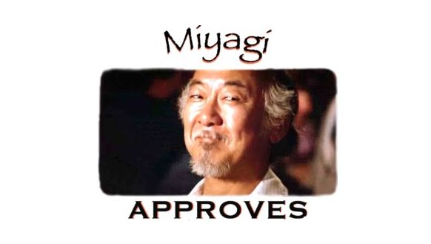

Slide 16
Next Steps...
Now: 15 min break
Grab a coffee
Stay here to enjoy next presentation
Change track and switch to another room
Ask me questions or meet me in a breakout session room afterwards

Slide 17
Questions?

Slide 18
About_Author
Matt Hitchcock is a Senior Consultant at Microsoft. He is a former Cloud and Datacenter MVP.
Based in Singapore, Matt‘s team covers Secure Infrastructure for Asia Pacific and Japan.
Cloud & Datacenter | Cyber Security | Devices & Mobility | Identity & Security
Email: matthew.hitchcock@microsoft.com
Twitter: hitchysg_msft
GitHub: github.com/matthitchcock

